Slide 1
SQL Data Analysis Netflix Dataset
An in-depth SQL analysis of Netflix data
Presented by: Bablu Maurya
Date: 02/06/2024

Slide 2
Project & dataset Overview
"This project aims to analyze Netflix data to uncover key trends and insights.“
Dataset Description:-The dataset includes Netflix titles with information on type, show_id,title, director, cast, country, date added, release year, rating, duration, listed_in, and description

Slide 3
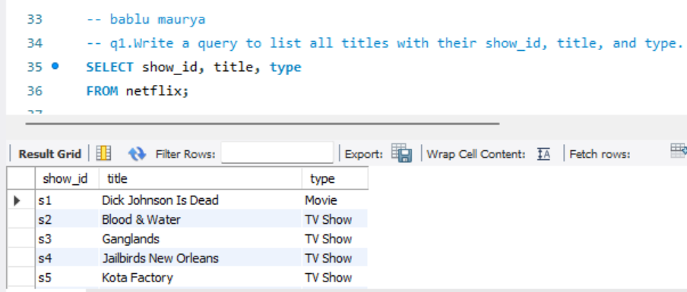
Queries
Q1.List all titles with their show_id, title, and type.
Explanation: This query retrieves the show_id, title, and type for all titles in the Netflix dataset. It provides a basic overview of the content available, categorized by its unique identifier (show_id), name (title), and type (either Movie or TV Show).

Slide 4
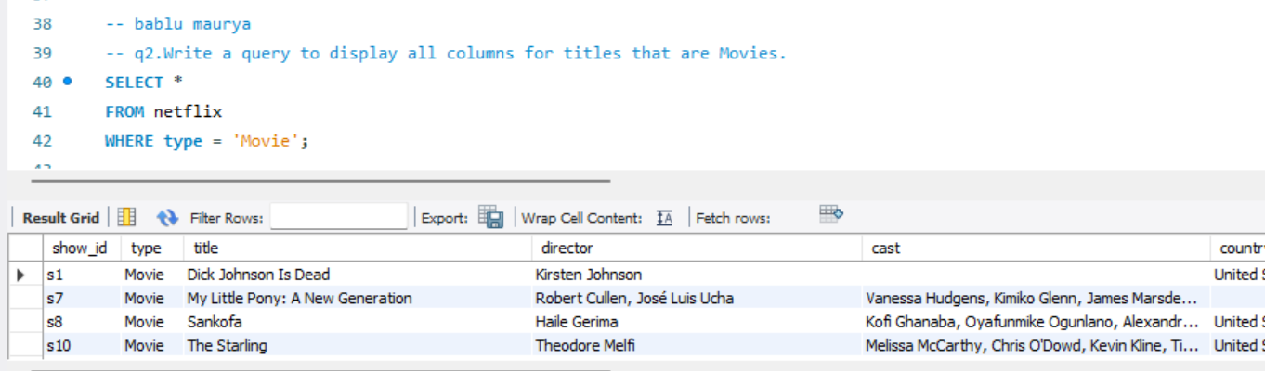
Queries
Q2. Display all columns for titles that are Movies.
Explanation: This query selects all columns for rows where the type is 'Movie'. It helps in analyzing detailed information about the movies in the dataset.

Slide 5
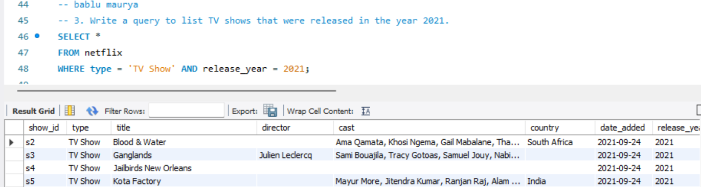
Queries
Q3. List TV shows released in the year 2021.
Explanation: This query filters the dataset to list all TV shows that were released in 2021. It is useful for understanding recent TV show releases.

Slide 6
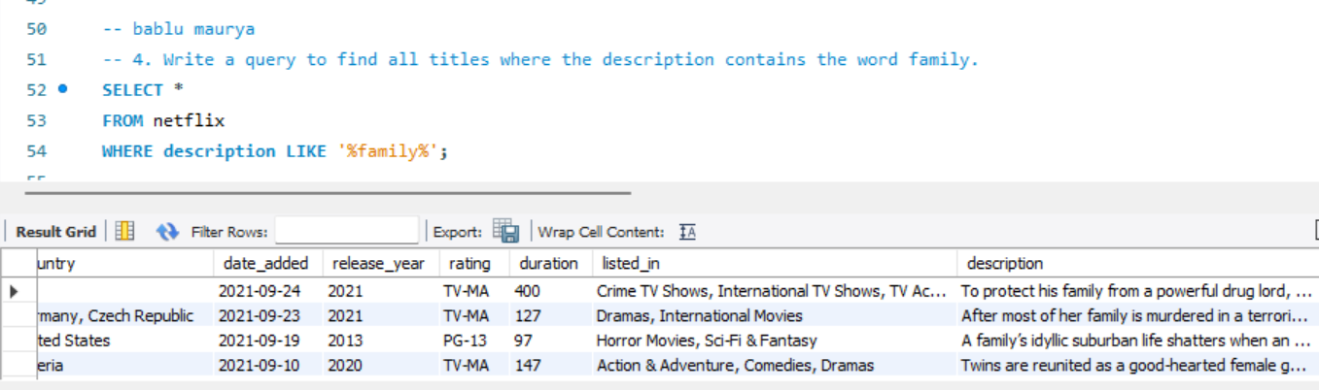
Queries
Q4. Find all titles where the description contains the word 'family'.
Explanation: This query searches for titles whose descriptions contain the word 'family'. It helps identify family-friendly content.

Slide 7
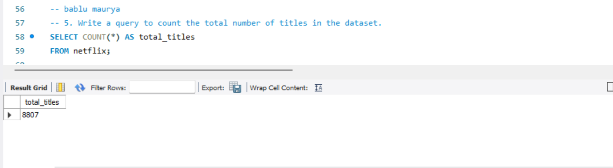
Queries
Q5. Count the total number of titles in the dataset.
Explanation: This query counts the total number of titles in the dataset. It provides a simple metric of dataset size.

Slide 8
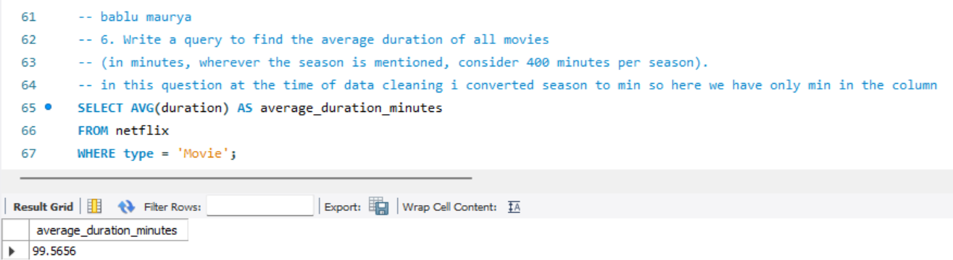
Queries
Q6. Find the average duration of all movies
Explanation: This query calculates the average duration of movies. It is useful for understanding the typical length of movies in the dataset.

Slide 9
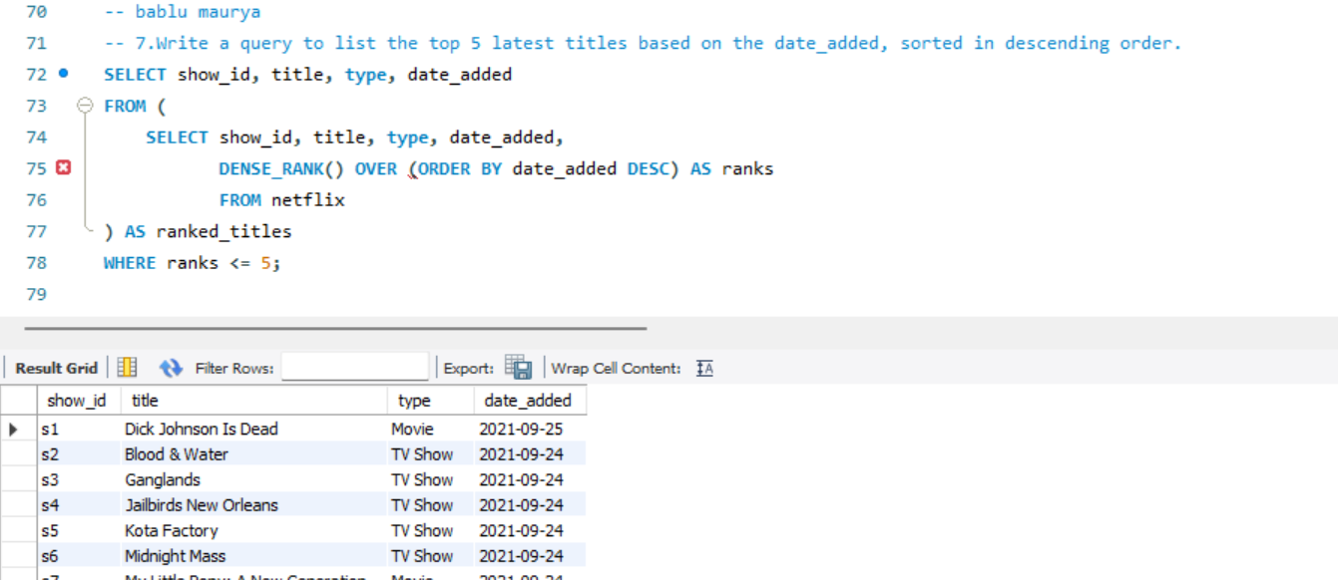
Queries
Q7. List the top 5 latest titles based on the date_added.
Explanation: This query ranks titles based on their date_added and lists the top 5 latest titles. The subquery assigns ranks to each title using DENSE_RANK() ordered by date_added in descending order. The outer query filters the results to include only those with a rank of 5 or less.

Slide 10
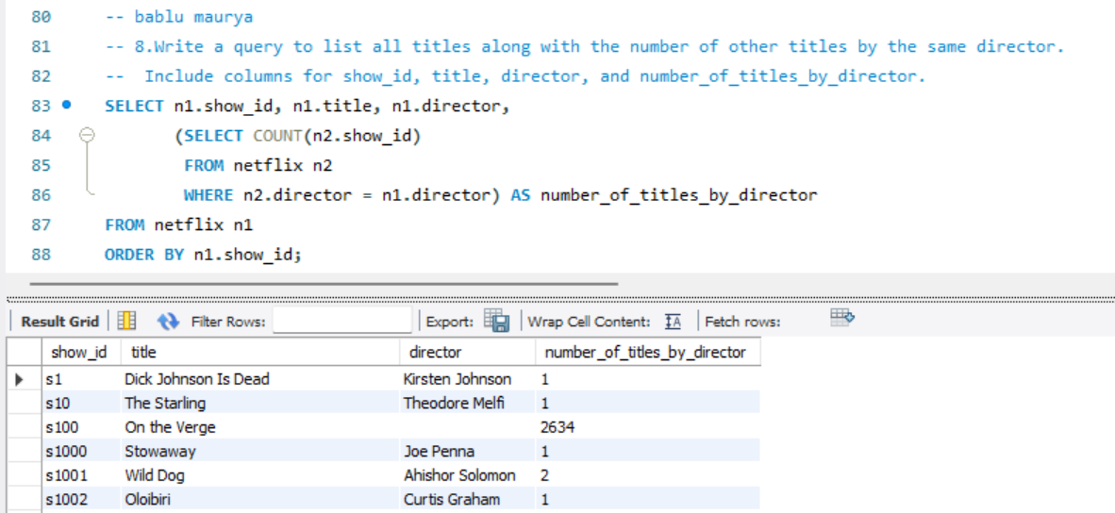
Queries
Q8. List all titles along with the number of other titles by the same director.
Explanation: This query lists each title along with the number of other titles by the same director. It shows the productivity of directors in the dataset.in this query we use inner query for finding the count of all for same director.

Slide 11
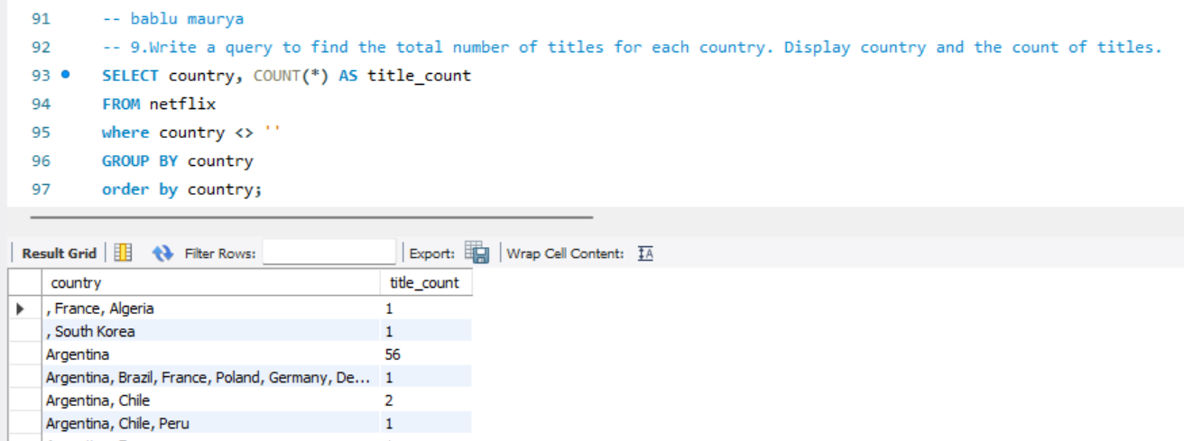
Queries
Q9. Find the total number of titles for each country.
Explanation: This query counts the total number of titles for each country. It helps in understanding the distribution of content across different countries.

Slide 12
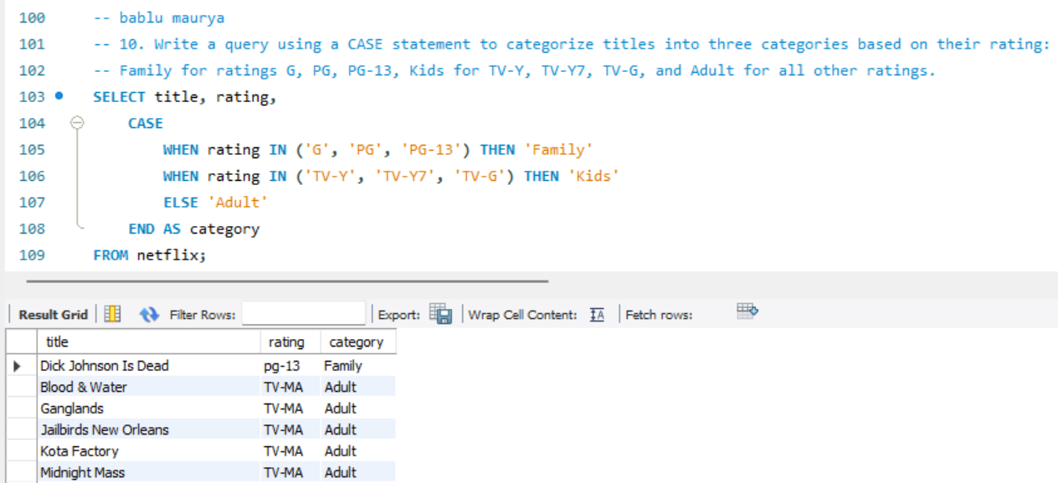
Queries
Q10. Categorize titles into three categories based on their rating.
Explanation: This query categorizes titles into 'Family', 'Kids', and 'Adult' based on their ratings. It simplifies the understanding of content categories.

Slide 13
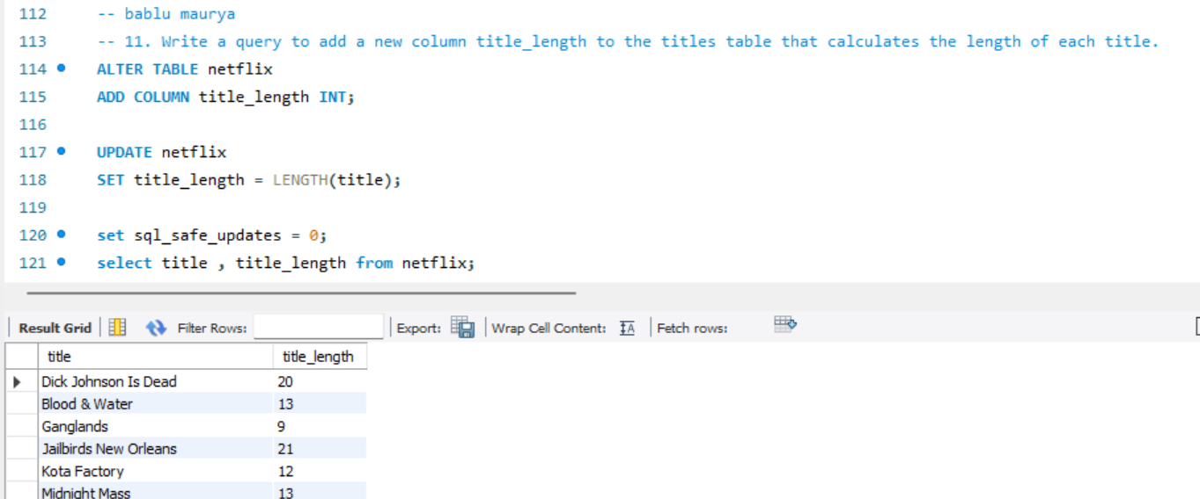
Queries
Q11. Add a new column title_length to calculate the length of each title.
Explanation: This query adds a new column to store the length of each title. It provides additional metadata for each title. Here I use alter for adding new column and update for updating value.

Slide 14
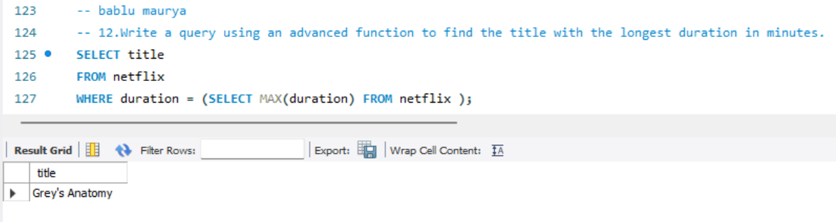
Queries
Q12. Find the title with the longest duration in minutes.
Explanation: This query finds the title with the longest duration. It identifies the lengthiest content available in the dataset. Here I use inner query for find the max duration and main query give all max duration title.

Slide 15
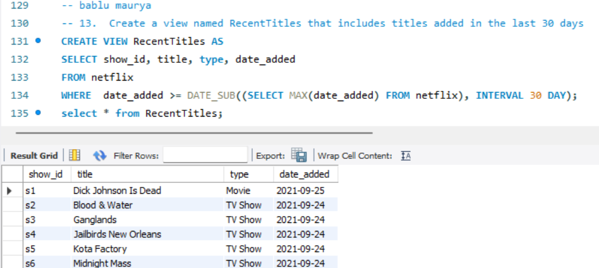
Queries
Q13. Create a view named RecentTitles that includes titles added in the last 30 days.
Explanation: This query creates a view to list titles added in the last 30 days. It helps in focusing on the most recent additions. Here date_sub is use to find last 30 day.

Slide 16
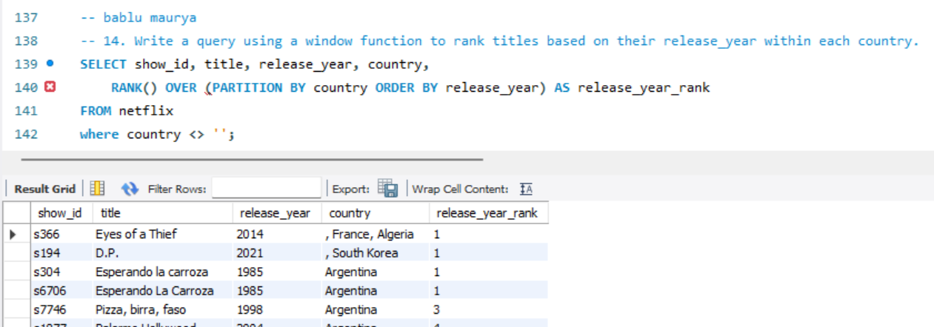
Queries
Q14.Rank titles based on their release_year within each country.
Explanation: This query ranks titles within each country based on their release year. It provides insights into the historical release patterns. I use here window function for ranking the released year

Slide 17
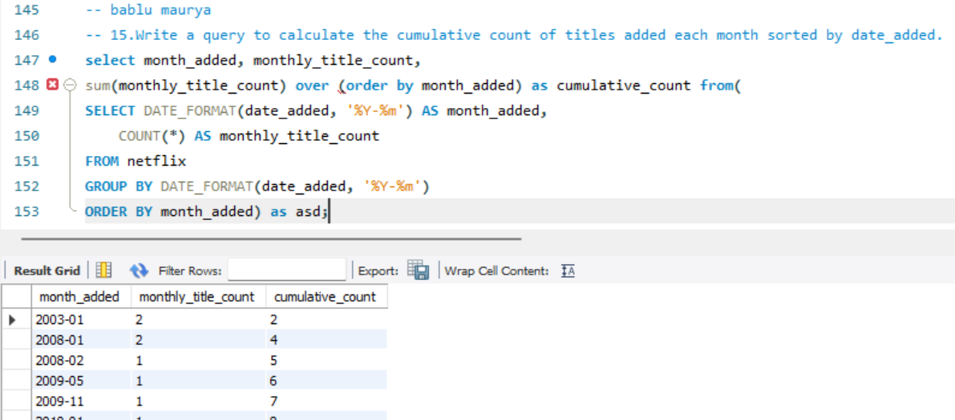
Queries
Q15. Calculate the cumulative count of titles added each month.
Explanation: This query calculates the cumulative count of titles added each month. The inner subquery counts titles added each month ‘monthly_title_count’ and groups them by formatted ‘date_added’ The outer query uses SUM() OVER (ORDER BY month_added) to calculate the running total cumulative_count.

Slide 18
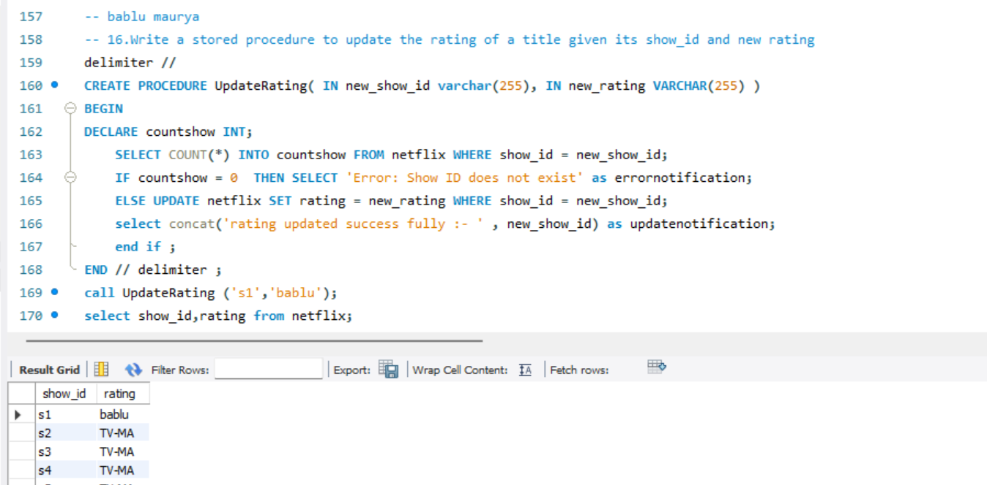
Queries
Q16. Stored procedure to update the rating of a title given its show_id and new rating.
Explanation:This stored procedure UpdateRating updates the rating of a title based on its show_id The procedure first checks if the show_id exists in the table. If it does not, it returns an error message. Otherwise, it updates the rating and confirms the update.

Slide 19
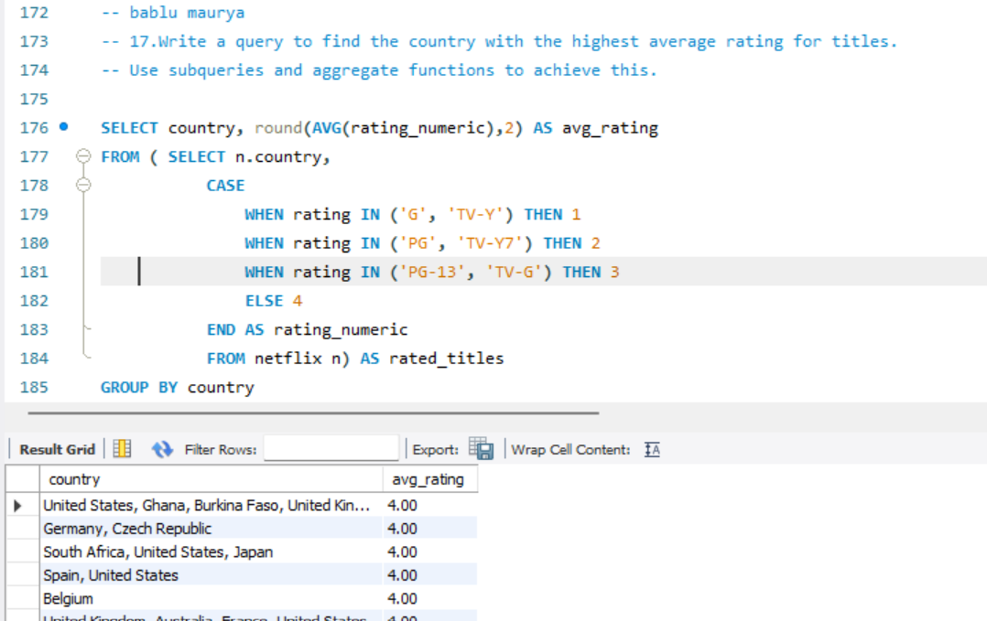
Queries
Q17. Find the country with the highest average rating for titles.
Explanation:The inner subquery converts ratings into numeric values. The CASE statement groups similar ratings and assigns them numeric values for easier calculation of averages. The outer query calculates the average AVG() of these numeric ratings for each country, rounds it to two decimal places ROUND() and returns the country with the highest average rating.

Slide 20
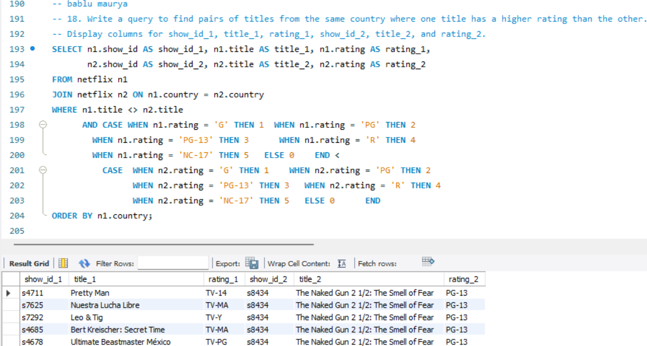
Queries
Q18. Find pairs of titles from the same country where one title has a hig her rating than the other.
Explanation:This query finds pairs of titles from the same country where one title has a higher rating than the other. The JOIN clause pairs titles from the same country n1.country = n2.country The WHERE clause ensures that the titles are different n1.title <> n2.title and and that the rating of the first title is higher than the second n1.rating > n2.rating as the rating is in varchar datatype we give them numerical value for comparing them The results are ordered by country.

Slide 21
Results
Insights:
The dataset contains a significant number of movies compared to TV shows.
Certain directors are highly prolific, contributing multiple titles to the dataset.
There are clear patterns in the types of titles released over the years and across different countries.
Key Findings:
Total titles in the dataset: 8807
Average movie duration:99.5656
Top 5 latest titles: Dick john is dead , blood & water , bangkok breaking ,dear white people , Avvai Shanmughi.
Country with highest average rating: united state with 4 .0 avg rating .

Slide 22
Conclusion
Summary:
The analysis provided valuable insights into the Netflix dataset.
Recommendations for future strategies and data handling were identified.
Next Steps:
Perform a deeper analysis on user engagement and ratings.
Explore additional datasets to enrich the analysis.
Implement recommendations based on insights gained.

Slide 23
References
Geekster. (n.d.). "Geekster - Your Career Accelerator." Retrieved from https://www.geekster.io/
LeetCode. (n.d.). "LeetCode - The World's Leading Online Programming Learning Platform." Retrieved from https://leetcode.com/
HackerRank. (n.d.). "HackerRank - Practice Coding, Prepare for Interviews, and Get Hired." Retrieved from https://www.hackerrank.com/
W3Schools. (n.d.). "W3Schools Online Web Tutorials." Retrieved from https://www.w3schools.com/

